Slide 2
Antra SEP Program
Hello World
Core Java Training 5

Slide 3
Day 5 Training Schedule
Collection Framework
Collections
Serialization

Slide 4
Basic Data Structure
List
Set
Queue
Map
Tree
Stack
...

Slide 5
Basic Data Structure
List: Elements are linked to each other.
Set: All elements are unique.
Queue: First in first out.
Map: Key-Value pair. Use key to get value.
Tree: Root has leaves to form a tree.
Stack: push it, pop it. First in, last out.

Slide 6
Java Collection Framework
Represent data items that form a natural group
Example: Students in a class. Options in a drop-down list. Records in a database table.
Based on different requirement, use different data structure to implement collection interface.

Slide 7
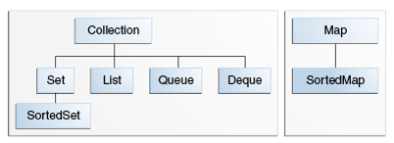
Collection
core collection interfaces.
These are all interfaces.
Java provides implementations for those interfaces.

Slide 8
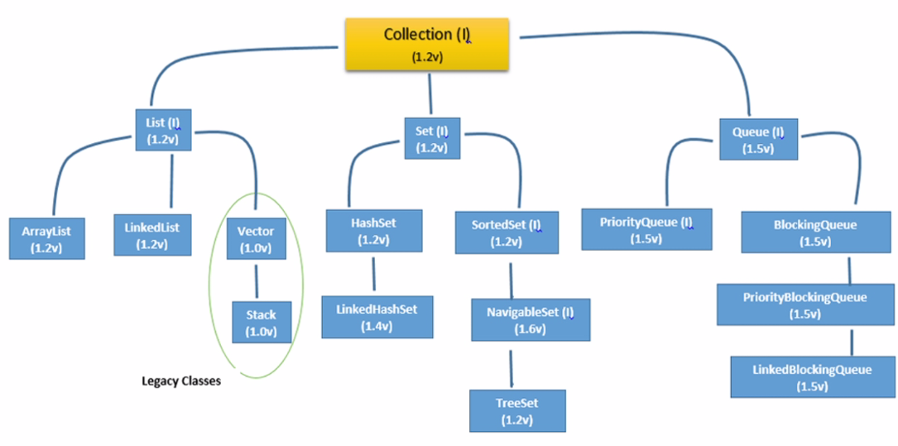

Slide 9
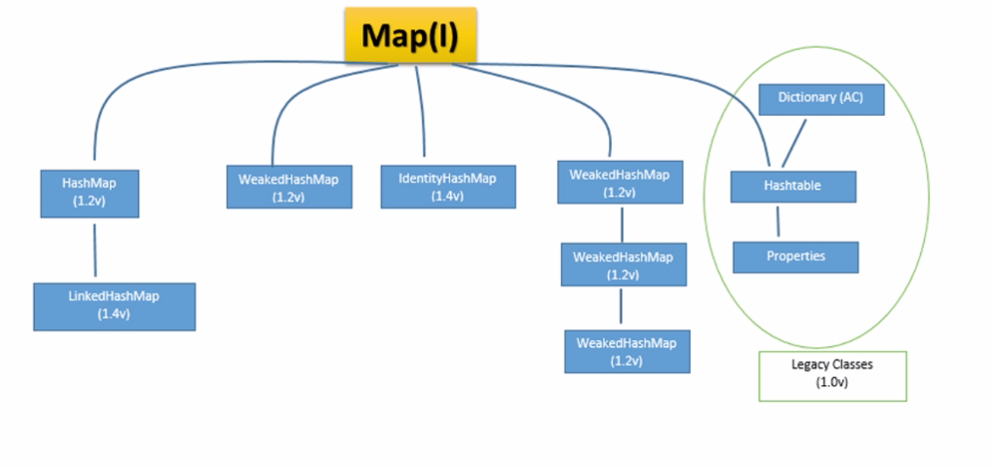

Slide 10

Set—No Duplication
Main implementations : HashSet, TreeSet, and LinkedHashSet.
Set<String> aSet = new HashSet<String>(); aSet.add(“a string”); aSet.remove(“a string”);
Iteration Iterator? Iterator<String> ite = aSet.iterator(); while(ite.hasNext()){ String s = ite.next(); …. }
for each loop. can be used in all collections but map. for (String s : aSet){…}

Slide 11
Example Class - Employee
1. Create class Employee
2. Create a test class EmployeeTest
3. Create a Set of employee's
4. Add some employee into the set.
5. Traverse the set and see what are added.
6. Override equals/hasCode methods.
7. Redo step 4 and 5.

Slide 12
List—Ordered
ArrayList List<String> aList = new ArrayList<String>(); aList.add(“hello”); aList.add(“world”);
Positional access String s = aList.get(0);
Iteration for(int i = 0 ; i < aList.size();i++){ String s = aList.get(i); } for(String s: aList){ … } Iterator<String> ite = aList.iterator(); ….

Slide 13
Queue — FIFO
First come first serve.
Exception is priority queue. It sorted the queue when adding.
add(), peek(), poll()
less often used.
Dequeue - Two way queue

Slide 14
Map — Key to Value
A map cannot contain duplicate keys: Each key can map to at most one value
Key can be null. Value can be null.
The Map interface includes methods for basic operations (such as put, get, remove, containsKey, containsValue, size, and empty), bulk operations (such as putAll and clear), and collection views (such as keySet, entrySet, and values).
Map<KeyType,ValueType> aMap = new HashMap<K,V>();
Map<String, Car> carMap = new HashMap<>(); carMap.put(“bmw”, new Car()); carMap.put(“lexus”,new Car()); Car aCar = carMap.get(“bmw”);
Iteration? use Key, use Entry.
carMap.keySet(); carMap.entrySet(); carMap.values();
for (Map.Entry<String, Car> e : m.entrySet()){ System.out.println(e.getKey() + ": " + e.getValue()); }

Slide 15
Demo - HashTable HashMap
HashMap Hashtable
Synchronized No Yes
Null Keys and Null values One null key not permit
null values null keys and values
Iterator type Fail fast iterator Fail safe iterator
Performance Faster Slower

Slide 16
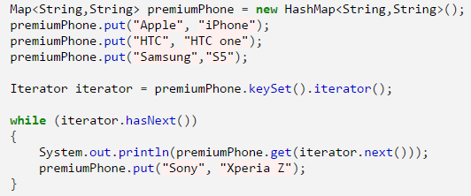
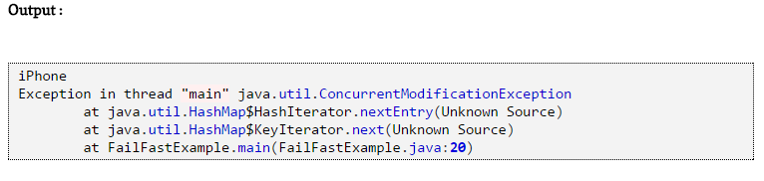
Fail Fast
http://javahungry.blogspot.com/2014/04/fail-fast-iterator-vs-fail-safe-iterator-difference-with-example-in-java.html

Slide 17
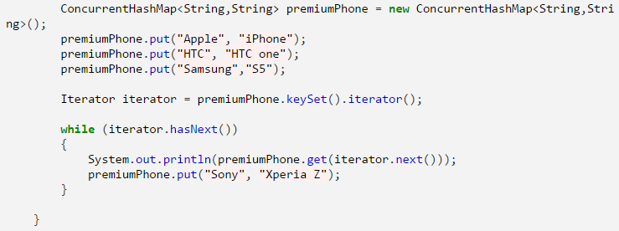
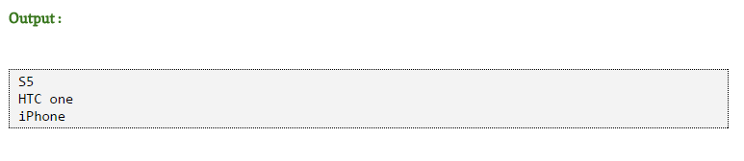
Fail Safe

Slide 18
Object Ordering
A List l may be sorted as follows.
Collections.sort(l);
The elements in I must implements comparable interface. Otherwise, use comparator.
This class consists exclusively of static methods that operate on or return collections.
Comparator interface.
Collections.sort(new ArrayList<Object>(), new Comparator() @Override public int compare(Object o1, Object o2) { return 0; } } );

Slide 19
Demo- Sort Employee
Using comparator
Using comparable interface

Slide 20
Generic
List aList = new ArrayList(); aList.add(new Integer(1)); aList.add("a string"); String str = (String)aList.get(1); //Explicit casting
List<String> aList = new ArrayList<String>();
aList.add(new Integer(1)); //wrong aList.add("a string"); String str = aList.get(0);

Slide 21
Generics - Why use generics
Compile-time type safety
Avoid the risk of casting
Generic Method

Slide 22
Generics and Subtyping
List<String> ls = new ArrayList<String>(); // 1 List<Object> lo = ls; // 2 compilation error
List<Object> is NOT a super type of List<String> even though Object is a super type of String.
But, what if:
List<String> ls = new ArrayList<String>(); // 1 List lo = ls; // 2

Slide 23
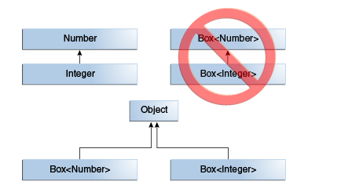

Slide 24
Generic Method
static void fromArrayToCollection(Object[] a, Collection<?> c) { for (Object o : a) {
c.add(o); // compile-time error
}
}
Cannot add to a unknown type collection.
static <T> void fromArrayToCollection(T[] a, Collection<T> c) {
for (T o : a) {
c.add(o); // Correct
}
}
Integer[] ia = new Integer[100];
Collection<Number> cn = new ArrayList<Number>();
fromArrayToCollection(ia, cn);

Slide 25
Type Parameter Naming Conventions
E - Element (used extensively by the Java Collections Framework)
K - Key
N - Number
T - Type
V - Value
S,U,V etc. - 2nd, 3rd, 4th types

Slide 26
Regular Express
Serialization
JDBC
Thread
Java I/O

Slide 27
Thanks!

